Slide 1

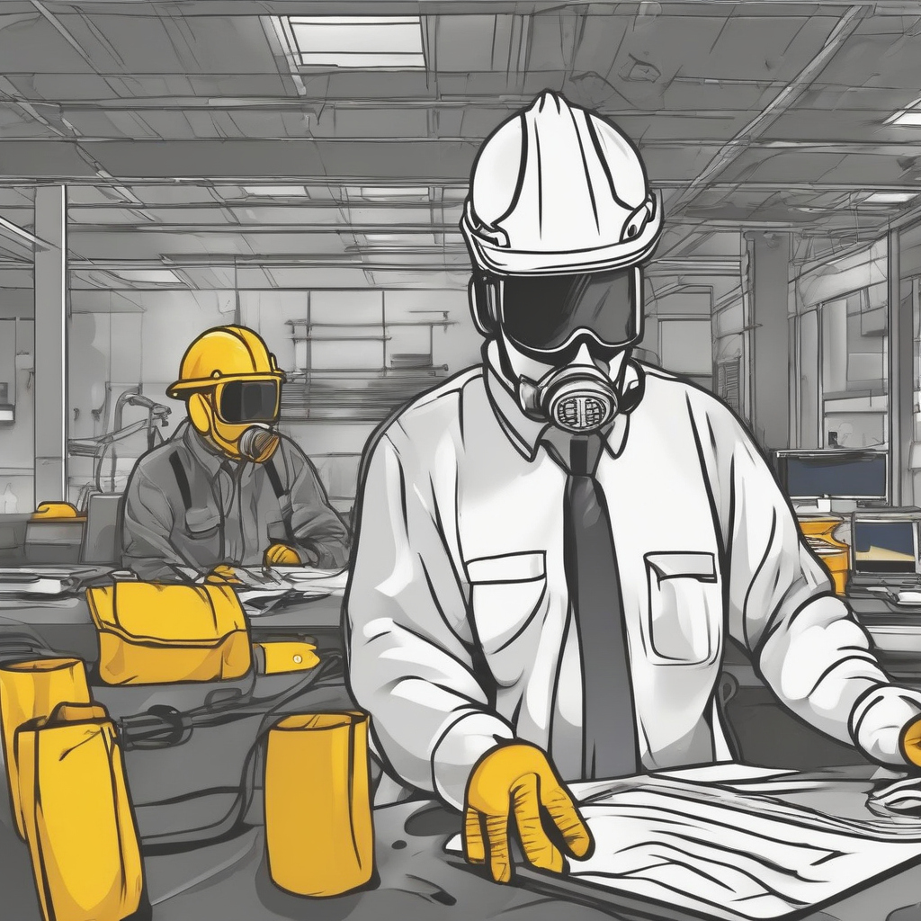
GearCheck AI
Group:8
Student Name​ | Student Id​
Muhammad Bilal Dilbar ​ | 101494128​
Krishna Ashokbhai Zala​ | 101499418​
Simran Nisarg Modi​ | 101486407​
Gowtham Katari​ Professors: Vejey Gandyer and Moe Fadaee | 101479063​

Slide 2
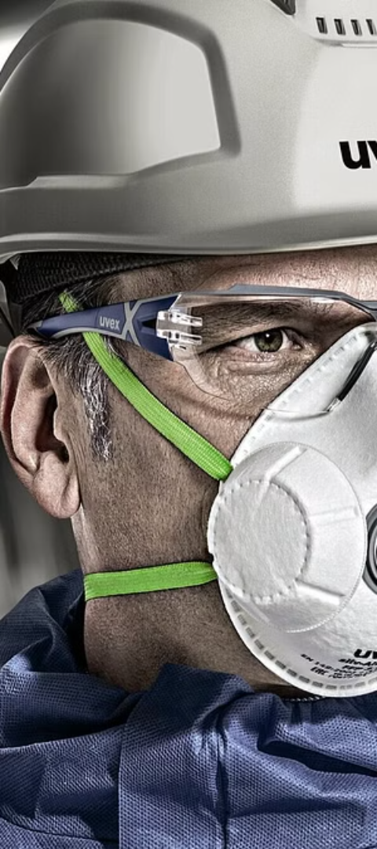
Agenda
Introduction
Problem Statement
Significance
Solution
Cost/Benefit Analysis
Business case
KPIs
Literature Reviews
ML Canvas
Model Training & Benchmarking
Model Deployment
Demo/Proof of concept
Challenges & Issues Encountered
Future Scope
Q & A

Slide 3
Introduction
The project aims to develop a computer vision-based solution for automating the detection of Personal Protective Equipment (PPE) in industries like construction ,medical and custom.
Utilizing the YOLOv8 deep learning architecture, the system seeks to accurately identify and classify various types of PPE such as Protective Helmet, Vest, Dust Mask, Glove ,Protective Boots.
Key Features:
Real-time detection capabilities for continuous monitoring of PPE compliance.
Robust performance under diverse environmental conditions and varying camera angles.
Expected Outcomes:
Increased efficiency in PPE inspection processes.
Enhanced workplace safety standards and reduced accident rates.

Slide 4
Problem Statement
Identifying the lack of personal protective equipment (PPE) in workplace environments poses a significant safety risk.
Lack of effective and efficient methods for automated PPE detection leads to potential safety hazards and compliance issues.
Current manual inspection processes are time-consuming, prone to errors, and not scalable.

Slide 5
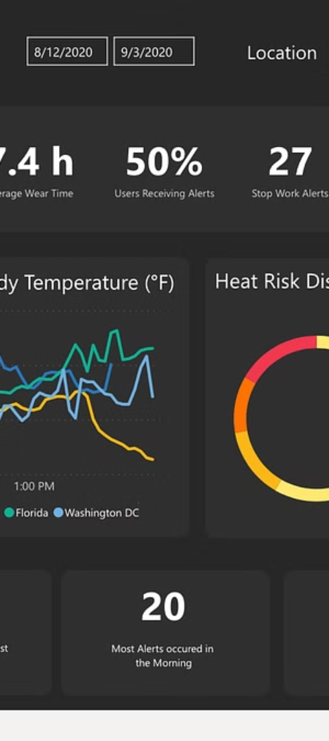
Significance
Automation improves PPE detection, enhancing workplace safety and fostering a safety-focused culture.
Minimizing human error in PPE inspection creates safer working environments and lowers accident risks.
Enhanced PPE compliance reduces workplace incidents, insurance claims, and regulatory fines.

Slide 6
Cost/Benefit Analysis:
Cost Analysis:
Initial development costs including hardware, software.
Ongoing maintenance and support expenses.
Integration costs with existing infrastructure and surveillance systems.
Benefit Analysis:
Reduction in accident rates and associated costs (medical expenses, worker compensation, legal fees).
Improved productivity due to streamlined PPE inspection processes.
Long-term cost savings through automation and efficiency gains.

Slide 7
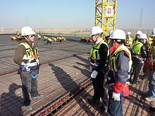
Business Case
Market Opportunity:
Growing emphasis on workplace safety regulations and compliance.
Increasing adoption of automation technologies in industrial sectors.
Potential for expansion into other industries beyond manufacturing, such as construction and healthcare.
Competitive Advantage:
Unique selling proposition (USP) of real-time PPE detection and compliance monitoring.
Differentiation through advanced deep learning algorithms and robust performance.
Revenue Model:
Licensing fees for software usage.
Subscription-based models for ongoing support and updates.
Customization and integration services for specific client needs.
This Photo by Unknown author is licensed under CC BY-SA.

Slide 8
KPIs(Key Performance Indicators):
Performance Metrics:
Accuracy and precision of PPE detection.
Detection speed and real-time processing capabilities.
False alarm rates and system reliability.
Business Metrics:
Return on Investment (ROI) based on cost savings and revenue generation.
Customer satisfaction and retention rates.
Market share and penetration in target industries.
Operational Metrics:
System uptime and availability.
Response time to alerts and incidents.
Scalability and adaptability to changing operational needs.

Slide 9
Literature Review
Past Available Projects:
COVID-19 PPE Dataset for Object Detection, Safety Helmet Detection, etc.
Revealed a gap in automated PPE detection solutions.
Existing methods lack robustness, scalability, and real-time performance.
Previous attempts relied on traditional computer vision techniques, struggling with complex environments and varying lighting conditions.
Drawbacks of Existing Solutions:
Low accuracy, limited adaptability, and high computational requirements.
Challenges like occlusion, small object detection, and class imbalance remain unresolved in many projects.
Our Project:
Developed a single object detection model for various PPE types: fall-detection, safety helmets, masks, gloves, vests, coats, glasses, etc., tailored for construction, medical, and diverse industries.

Slide 10
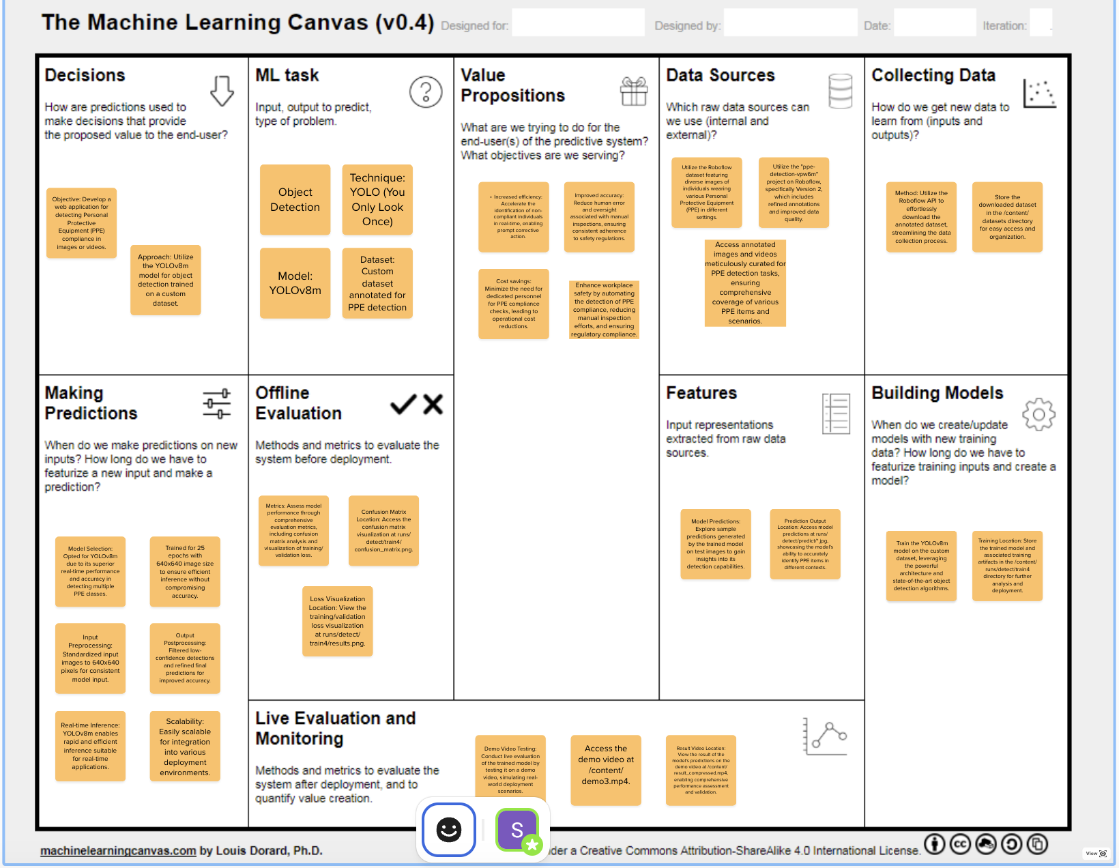
Methodology – ML Canvas:

Slide 11
Model Training & Benchmarking:
Data Collection:
First labeled dataset from Roboflow for Construction PPE with 2197 total images of PPE.
Class Labels: boots, gloves, helmet, vest
Second labeled dataset from Roboflow for Medical PPE with 1099 total images of PPE.
Class Labels: coat, glasses, glove, mask
Third label dataset from Roboflow for Custom PPE with 44002 total images of PPE.
Class Labels: fall-detected, gloves, goggles, hard-hat, ladder, mask etc.
Data Preparation:
Conducted preprocessing for image augmentation
Ensured dataset balance across PPE categories to avoid bias.
Model Training:
Used YOLOv8 architecture with transfer learning for PPE detection.
Fine-tuned the model for enhanced performance on the custom dataset.
Evaluation Metrics:
Achieved 75% accuracy in PPE item identification.
Evaluated using precision, recall, and mAP50-95 metrics.
Key Achievements:
Improved detection accuracy compared to traditional methods.
Demonstrated robust performance in real-world environments.
Validated effectiveness through benchmarking against existing solutions.

Slide 12
Model Training & Benchmarking:
Model | Dataset | Epochs | Precision | Recall | mAP50-95
Yolov8m | Construction PPE | 24 | 0.86859 | 0.8072 | 0.64982
Yolov8m | Medical PPE | 49 | 0.75158 | 0.67678 | 0.37554
Yolov8m | Custom PPE | 9 | 0.62304 | 0.64247 | 0.36837

Slide 13
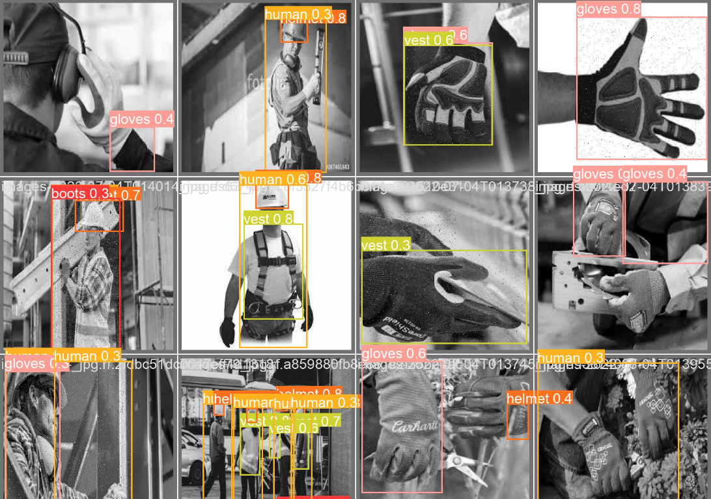
Deployment Environment:
Utilized Render for deploying the PPE detection model.
Deployment Files:
Notebook: Used for model training and experimentation.
Python Script (Yolo_Video_Detection.py): Contains code for real-time video detection.
Main Script (main.py): Handles web application functionalities.
Requirements.txt: Lists necessary dependencies for the project.
Model Deployment:

Slide 14
Demo:
Construction PPE Detection: Experience the power of our model as it accurately identifies crucial safety gear like helmets, vests, and goggles, vital for construction site personnel's protection.
Medical PPE Detection: Witness the precision of our model in recognizing essential medical gear such as masks, gloves, and gowns, pivotal for safeguarding healthcare professionals on the frontline.
Custom PPE Detection: Explore the versatility of our custom model, adept at detecting a diverse array of PPE across various industries. From standard safety equipment to specialized features like fall detection, our solution ensures comprehensive safety monitoring tailored to your needs.

Slide 15
Challenges & Issues Encountered:
Limited annotated dataset availability posed initial challenges in model training and validation.
Overcoming computational resource constraints for training large-scale models, particularly in resource-constrained environments.
Addressing class imbalance and data distribution issues during model training to prevent bias and improve generalization.

Slide 16
Future Scope:
Model Enhancement: Improve model accuracy and robustness through fine-tuning and advanced techniques like attention mechanisms.
Real-Time Monitoring: Implement automated surveillance for continuous PPE compliance monitoring in industrial settings.
Cross-Sector Implementation: Extend PPE detection to diverse sectors including healthcare, construction, manufacturing, and more.
Public Spaces: Implement PPE detection in public spaces like airports, train stations, and malls to enforce safety regulations during pandemics and emergencies.

Slide 17
THANK YOU

Slide 21
SWOT Analysis:
Strengths:
Customized Solution: Tailoring the safety monitoring system to specific workplace needs.
Advanced Technology: Utilizing state-of-the-art AI and IoT technologies for accurate detection.
Comprehensive Training: Providing thorough training to employees for effective system utilization.
Weaknesses:
Initial Costs: High upfront investment required for equipment procurement and system setup.
Technical Challenges: Potential issues with system integration and software compatibility.
Resistance to Change: Employee resistance to adopting new monitoring practices due to privacy concerns.
Opportunities:
Market Expansion: Potential to expand the safety monitoring system to other industries or regions.
Product Enhancement: Continuously improving the system based on feedback and technological advancements.
Partnership Opportunities: Collaborating with technology providers to enhance product features and capabilities.
Threats:
Regulatory Changes: Changes in safety regulations and compliance requirements may impact system implementation.
Competitor Activity: Increased competition from other safety solution providers offering similar products.
Data Security Risks: Potential cybersecurity threats and data breaches compromising sensitive information.

Slide 22
PESTLE Analysis:
Political:
Government regulations regarding workplace safety standards.
Legislative changes impacting safety compliance requirements.
Economic:
Cost implications of implementing the solution vs. potential savings from reduced accidents.
Economic downturn affecting budget allocations for safety initiatives.
Social:
Employee attitudes towards safety monitoring and privacy concerns.
Cultural factors influencing acceptance of technology-driven safety measures.
Technological:
Advancements in AI and IoT impacting the evolution of safety solutions.
Availability of innovative PPE detection technologies.
Legal:
Compliance with data protection laws and regulations.
Liability implications in case of accidents due to non-compliance.
Environmental:
Impact of workplace accidents on the environment and sustainability goals.
Adoption of eco-friendly safety equipment.

Slide 23
Risk Analysis:
Identification of Potential Risks and Uncertainties:
Model inaccuracies leading to false detections or missed violations.
Resistance from employees or unions towards monitoring initiatives.
Regulatory changes impacting compliance requirements.
Likelihood and Impact Assessment:
Assessing the probability and severity of each risk.
High-impact risks requiring immediate attention and mitigation strategies.
Risk Mitigation Strategies:
Continuous model refinement through data augmentation and feedback loops.
Employee training and communication to address resistance and privacy concerns.
Proactive monitoring of regulatory changes and timely updates to compliance protocols.

Slide 24
Methodology – ML Canvas:
Data Preprocessing: Prior to training, the dataset undergoes thorough preprocessing steps such as normalization, resizing, and augmentation to enhance model robustness and generalization.
Hyperparameter Optimization: Rigorous experimentation with hyperparameters such as learning rate, batch size, and optimizer selection to fine-tune model performance and convergence speed.
Model Interpretability: Implementation of techniques for model interpretability such as Grad-CAM and occlusion sensitivity analysis to gain insights into model decision-making processes.
Ensemble Techniques: Exploration of ensemble learning methodologies to combine predictions from multiple models, enhancing overall detection accuracy and robustness.
Deployment Flexibility: Provision for model deployment on various platforms including cloud-based servers, edge devices, and mobile applications to cater to diverse deployment scenarios.
Continuous Monitoring: Establishment of mechanisms for continuous monitoring of model performance post-deployment, facilitating timely updates and maintenance.

Slide 25
Model Benchmarking:
Achieved significant improvements in detection accuracy compared to baseline models.
Demonstrated superior performance in real-world scenarios, with high precision and recall rates across various PPE categories.
Evaluation on standard datasets and benchmarking against state-of-the-art models validates the effectiveness of the proposed approach.

Slide 26
Model Benchmarking:
Custom Evaluation Metrics: Development of specialized evaluation metrics tailored to the nuances of PPE detection tasks, ensuring comprehensive assessment of model performance.
Real-world Simulation: Simulation of real-world scenarios during model evaluation to validate its efficacy in dynamic environments with varying lighting conditions, occlusions, and perspectives.
Cross-domain Validation: Validation of model robustness across different domains and environments through cross-domain validation techniques, ensuring versatility and adaptability.
Long-term Evaluation: Long-term evaluation of model performance to assess its sustainability and resilience to evolving environmental conditions and operational challenges.
Industry Standards Compliance: Adherence to industry-specific safety standards and regulations, ensuring compliance and fostering trust among stakeholders.

Slide 27
Model Deployment:
Seamless integration of the trained model into existing safety monitoring systems, including CCTV cameras and IoT devices.
Potential deployment across various industries, including manufacturing, construction, healthcare, and transportation.
Compatibility with edge computing platforms enables real-time inference at the point of need, reducing latency and bandwidth requirements.

Slide 28
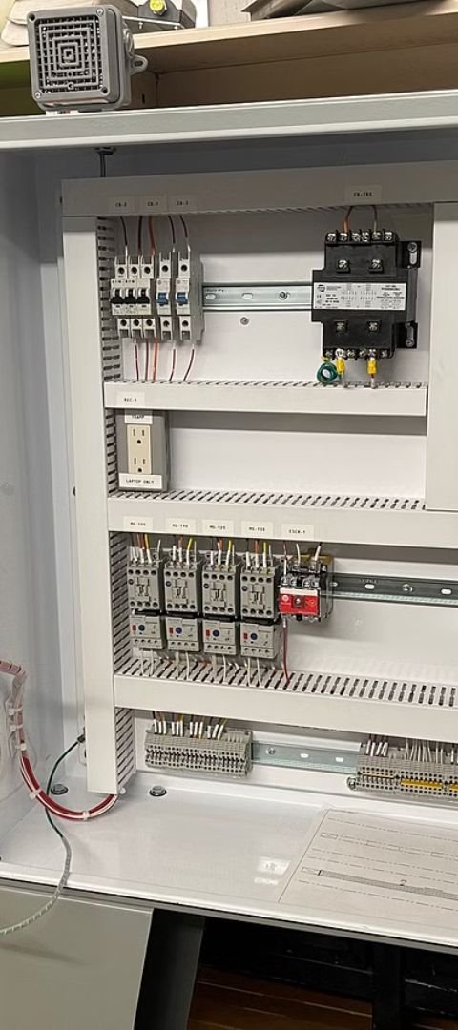
Continued...
Options:
Organizations can choose from flexible deployment options tailored to their specific needs, including cloud-based, on-premises, or hybrid solutions.
Customization options allow integration with existing safety systems, seamless workflow integration, and compatibility with a wide range of hardware platforms.
Partnering opportunities with equipment manufacturers, safety consultants, and regulatory agencies enhance solution adoption and industry collaboration.
Costs:
Initial investment in the automated PPE detection system includes hardware, software licensing, and implementation costs.
Long-term cost savings stem from reduced workplace incidents, lower insurance premiums, and improved productivity due to enhanced safety measures.
A comprehensive cost-benefit analysis demonstrates the potential return on investment (ROI) and highlights the tangible benefits of prioritizing workplace safety.

Slide 29
Demo:

Slide 30
Methodology – ML Canvas:
Methodology based on the YOLOv8 architecture for real-time object detection.
Utilization of transfer learning and data augmentation techniques to train the model on a custom PPE dataset.
Integration of performance metrics such as precision, recall, and mAP (mean Average Precision) for model evaluation and optimization.

Slide 31
Cost/Benefit Analysis:
Financial Costs vs. Potential Savings:
Investment in model development, data acquisition, and infrastructure.
Potential savings from reduced workplace accidents, insurance claims, and legal fees.
Tangible and Intangible Benefits of Adopting the Solution:
Tangible: Cost savings, increased productivity, reduced absenteeism.
Intangible: Improved safety culture, enhanced brand reputation, employee morale.

Slide 32
Conclusion:
Successful development of an automated PPE detection system using YOLOv8, addressing critical safety concerns in workplace environments.
Potential for widespread implementation across industries to enhance workplace safety, reduce accidents, and improve regulatory compliance.
Continued research and development efforts to further improve model performance, scalability, and adaptability to diverse operating conditions.

